Slide 1
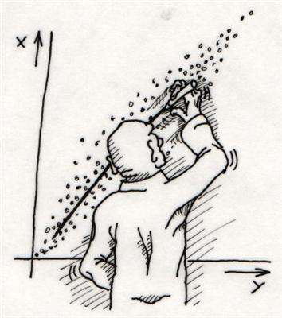
Line Detection

Slide 2
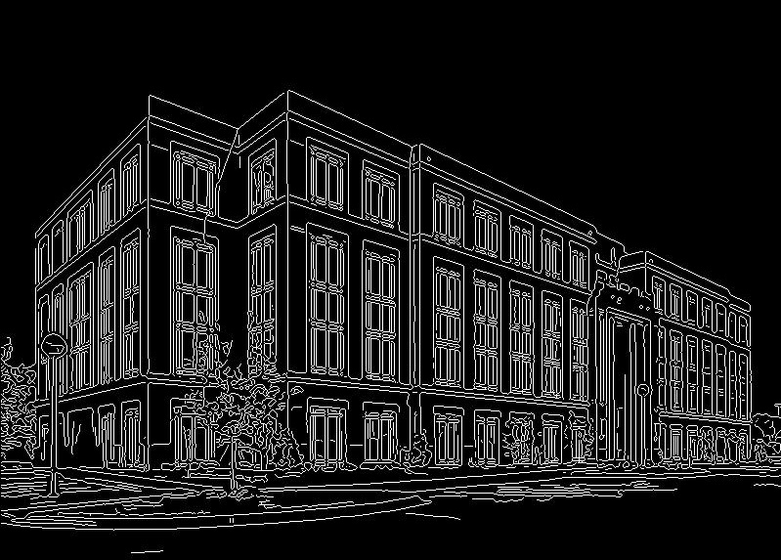
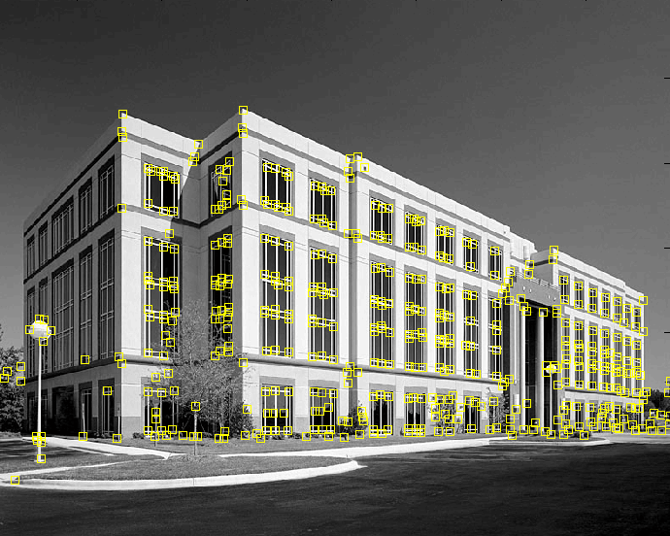
Fitting: Motivation
We’ve learned how to detect edges. Now what?
We would like to form a higher-level, more compact representation of the features in the image by grouping multiple features according to a simple model
9300 Harris Corners Pkwy, Charlotte, NC

Slide 3
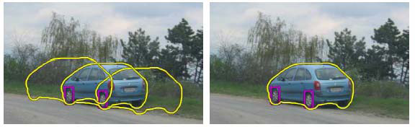
Fitting
Choose a parametric model to represent a set of features
simple model: lines
simple model: circles
complicated model: car
Source: K. Grauman

Slide 4
Fitting
Choose a parametric model to represent a set of features
Membership criterion is not local
Can’t tell whether a point belongs to a given model just by looking at that point
Three main questions:
What model represents this set of features best?
Which of several model instances gets which feature?
How many model instances are there?
Computational complexity is important
It is infeasible to examine every possible set of parameters and every possible combination of features

Slide 5
Line Grouping Problem

Slide 6
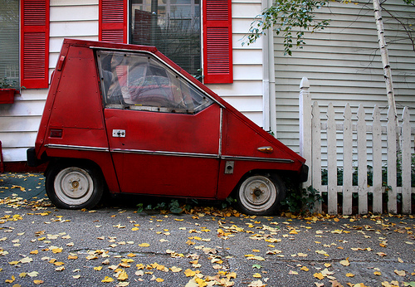
Issues
Noise in the measured feature locations
Extraneous data: clutter (outliers), multiple lines
Missing data: occlusions
Case study: Line detection

Slide 7
Voting schemes
Let each feature vote for all the models that are compatible with it
Hopefully, the noise features will not vote consistently for any single model
Missing data doesn’t matter as long as there are enough features remaining to agree on a good model

Slide 8
Hough transform
An early type of voting scheme
General outline:
Discretize parameter space into bins
For each feature point in the image, put a vote in every bin in the parameter space that could have generated this point
Find bins that have the most votes
Image space
Hough parameter space
P.V.C. Hough, Machine Analysis of Bubble Chamber Pictures, Proc. Int. Conf. High Energy Accelerators and Instrumentation, 1959

Slide 9
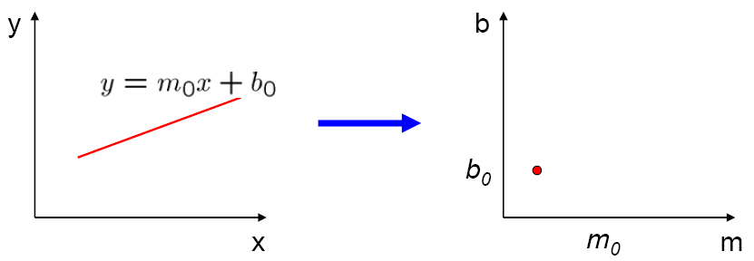
Parameter space representation
A line in the image corresponds to a point in Hough space
Image space
Hough parameter space
Source: K. Grauman

Slide 10
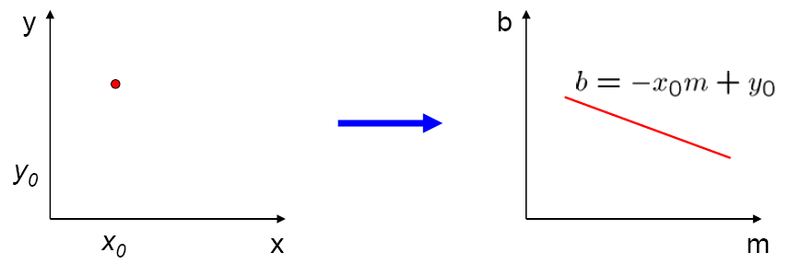
Parameter space representation
What does a point (x₀, y₀) in the image space map to in the Hough space?
Answer: the solutions of b = –x₀m + y₀
This is a line in Hough space
Image space
Hough parameter space
Source: K. Grauman

Slide 11
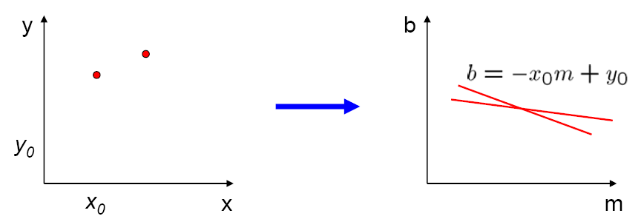
Parameter space representation
Where is the line that contains both (x₀, y₀) and (x₁, y₁)?
It is the intersection of the lines b = –x₀m + y₀ and b = –x₁m + y₁
Image space
Hough parameter space
(x₁, y₁)
(x₀, y₀)
b = –x₁m + y₁
Source: K. Grauman

Slide 12
Polar representation for lines
Problems with the (m,b) space:
Unbounded parameter domain
Vertical lines require infinite m

Slide 13
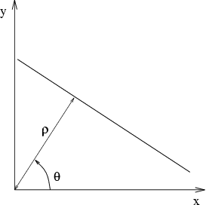
Polar representation for lines
Problems with the (m,b) space:
Unbounded parameter domain
Vertical lines require infinite m
Alternative: polar representation
Each point will add a sinusoid in the (θ,ρ) parameter space

Slide 14
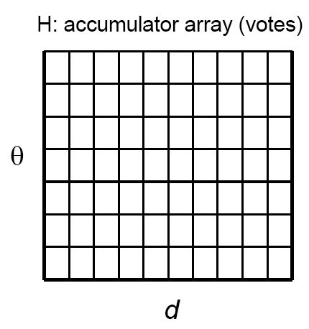
Algorithm outline
Initialize accumulator H to all zeros
For each edge point (x,y) in the image For θ = 0 to 180 ρ = x cos θ + y sin θ H(θ, ρ) = H(θ, ρ) + 1 end end
Find the value(s) of (θ, ρ) where H(θ, ρ) is a local maximum
The detected line in the image is given by ρ = x cos θ + y sin θ
ρ
θ

Slide 15
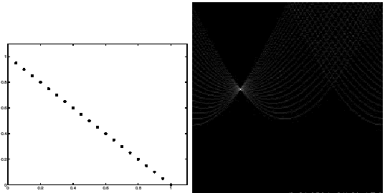
Basic illustration
features
votes
Notes:
Figure 15.1, top half. Note that most points in the vote array are very dark, because they
get only one vote.

Slide 16
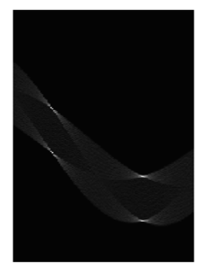
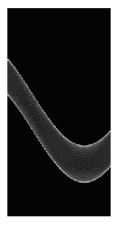
Other shapes
Square
Circle

Slide 17
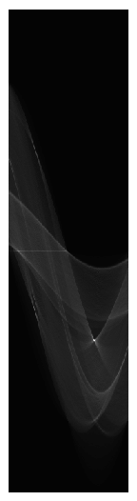
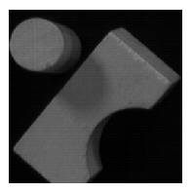
Several lines

Slide 18
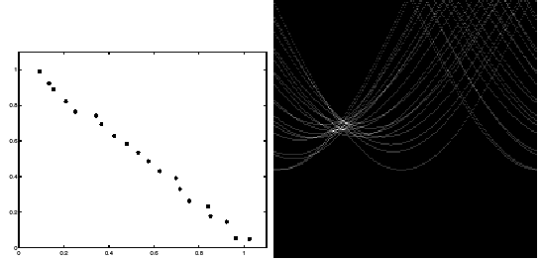
Effect of noise
features
votes
Peak gets fuzzy and hard to locate
Notes:
This is 15.1 lower half

Slide 19
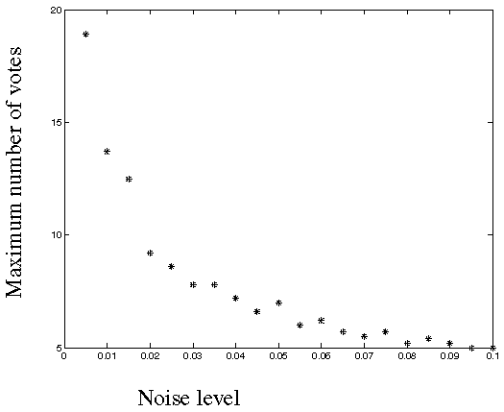
Effect of noise
Number of votes for a line of 20 points with increasing noise:
Notes:
This is the number of votes that the real line of 20 points gets with increasing noise (figure15.3)

Slide 20
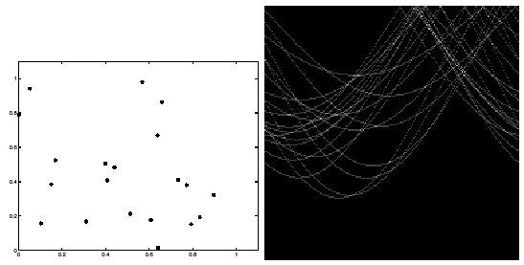
Random points
features
votes
Uniform noise can lead to spurious peaks in the array
Notes:
15.2; main point is that lots of noise can lead to large peaks in the array

Slide 21
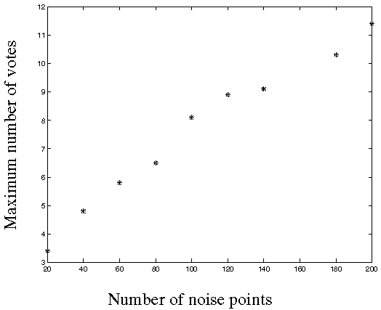
Random points
As the level of uniform noise increases, the maximum number of votes increases too:
Notes:
Figure 15.4; as the noise increases in a picture without a line, the number of points in the max cell goes
up, too

Slide 22
Practical details
Try to get rid of irrelevant features
Take edge points with significant gradient magnitude
Choose a good grid / discretization
Too coarse: large votes obtained when too many different lines correspond to a single bucket
Too fine: miss lines because some points that are not exactly collinear cast votes for different buckets
Increment neighboring bins (smoothing in accumulator array)
Who belongs to which line?
Tag the votes

Slide 23
Hough transform: Pros
All points are processed independently, so can cope with occlusion
Some robustness to noise: noise points unlikely to contribute consistently to any single bin
Can deal with non-locality and occlusion
Can detect multiple instances of a model in a single pass

Slide 24
Hough transform: Cons
Complexity of search time increases exponentially with the number of model parameters
Non-target shapes can produce spurious peaks in parameter space
It’s hard to pick a good grid size

Slide 25


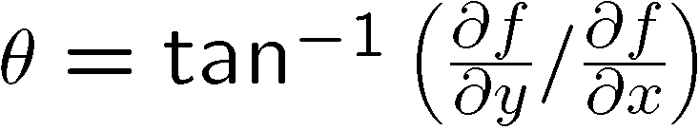
Extension: Incorporating image gradients
Recall: when we detect an edge point, we also know its gradient direction
But this means that the line is uniquely determined!
Modified Hough transform:
For each edge point (x,y) θ = gradient orientation at (x,y) ρ = x cos θ + y sin θ H(θ, ρ) = H(θ, ρ) + 1 end

Slide 26
Hough transform for circles
How many dimensions will the parameter space have?
Given an oriented edge point, what are all possible bins that it can vote for?

Slide 27
Hough transform for circles
image space
Hough parameter space
r
y
(x,y)
x
x
y

Slide 28

Hough transform for circles
Conceptually equivalent procedure: for each (x,y,r), draw the corresponding circle in the image and compute its “support”
r
x
y
What is more efficient: going from the image space to the parameter space or vice versa?

Slide 29
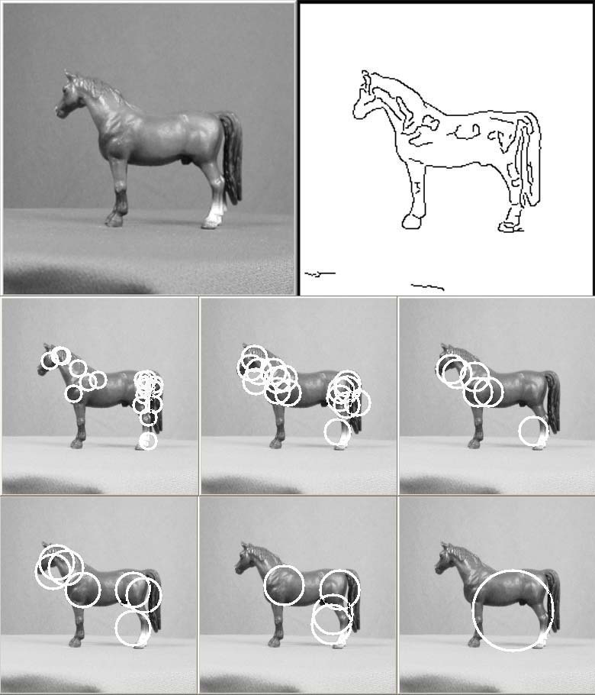

Application in recognition
F. Jurie and C. Schmid, Scale-invariant shape features for recognition of object categories, CVPR 2004

Slide 30
Hough circles vs. Laplacian blobs
Original images
Robustness to scale and clutter
Laplacian circles
Hough-like circles
F. Jurie and C. Schmid, Scale-invariant shape features for recognition of object categories, CVPR 2004

Slide 31
Generalized Hough transform
We want to find a shape defined by its boundary points and a reference point
a
D. Ballard, Generalizing the Hough Transform to Detect Arbitrary Shapes, Pattern Recognition 13(2), 1981, pp. 111-122.

Slide 32
Generalized Hough transform
We want to find a shape defined by its boundary points and a reference point
For every boundary point p, we can compute the displacement vector r = a – p as a function of gradient orientation θ
a
θ
r(θ)
p
D. Ballard, Generalizing the Hough Transform to Detect Arbitrary Shapes, Pattern Recognition 13(2), 1981, pp. 111-122.

Slide 33
Generalized Hough transform
For model shape: construct a table storing displacement vectors r as function of gradient direction
Detection: For each edge point p with gradient orientation θ:
Retrieve all r indexed with θ
For each r(θ), put a vote in the Hough space at p + r(θ)
Peak in this Hough space is reference point with most supporting edges
Assumption: translation is the only transformation here, i.e., orientation and scale are fixed
Source: K. Grauman

Slide 34
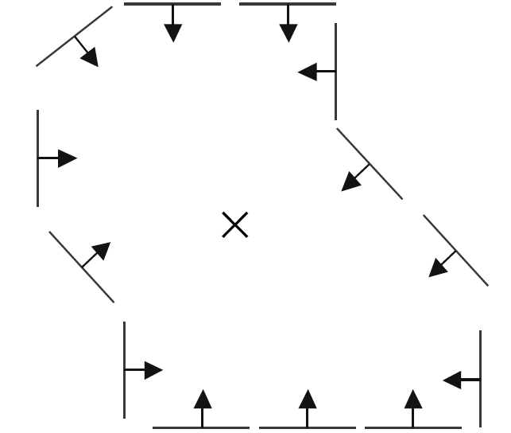
Example
model shape

Slide 35
Example
displacement vectors for model points

Slide 36
Example
range of voting locations for test point

Slide 37
Example
range of voting locations for test point

Slide 38
Example
votes for points with θ =

Slide 39
Example
displacement vectors for model points

Slide 40
Example
range of voting locations for test point

Slide 41
Example
votes for points with θ =

Slide 42
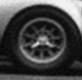
Application in recognition
Instead of indexing displacements by gradient orientation, index by “visual codeword”
visual codeword with displacement vectors
training image
B. Leibe, A. Leonardis, and B. Schiele, Combined Object Categorization and Segmentation with an Implicit Shape Model, ECCV Workshop on Statistical Learning in Computer Vision 2004

Slide 43
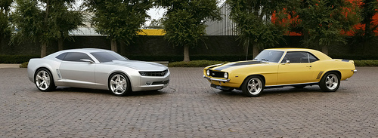
Application in recognition
Instead of indexing displacements by gradient orientation, index by “visual codeword”
test image
B. Leibe, A. Leonardis, and B. Schiele, Combined Object Categorization and Segmentation with an Implicit Shape Model, ECCV Workshop on Statistical Learning in Computer Vision 2004

Slide 44
Implicit shape models: Training
Build codebook of patches around extracted interest points using clustering (more on this later in the course)

Slide 45
Implicit shape models: Training
Build codebook of patches around extracted interest points using clustering
Map the patch around each interest point to closest codebook entry

Slide 46
Implicit shape models: Training
Build codebook of patches around extracted interest points using clustering
Map the patch around each interest point to closest codebook entry
For each codebook entry, store all positions it was found, relative to object center

Slide 47
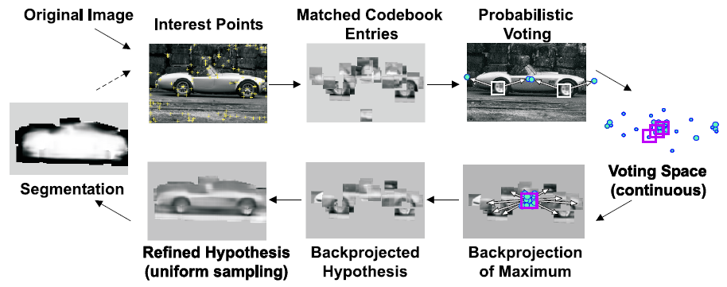
Implicit shape models: Testing
Given test image, extract patches, match to codebook entry
Cast votes for possible positions of object center
Search for maxima in voting space
Extract weighted segmentation mask based on stored masks for the codebook occurrences

Slide 48
Implicit shape models: Notes
Supervised training
Need reference location and segmentation mask for each training car
Voting space is continuous, not discrete
Clustering algorithm needed to find maxima
How about dealing with scale changes?
Option 1: search a range of scales, as in Hough transform for circles
Option 2: use scale-invariant interest points
Verification stage is very important
Once we have a location hypothesis, we can overlay a more detailed template over the image and compare pixel-by-pixel, transfer segmentation masks, etc.

